Slide 1
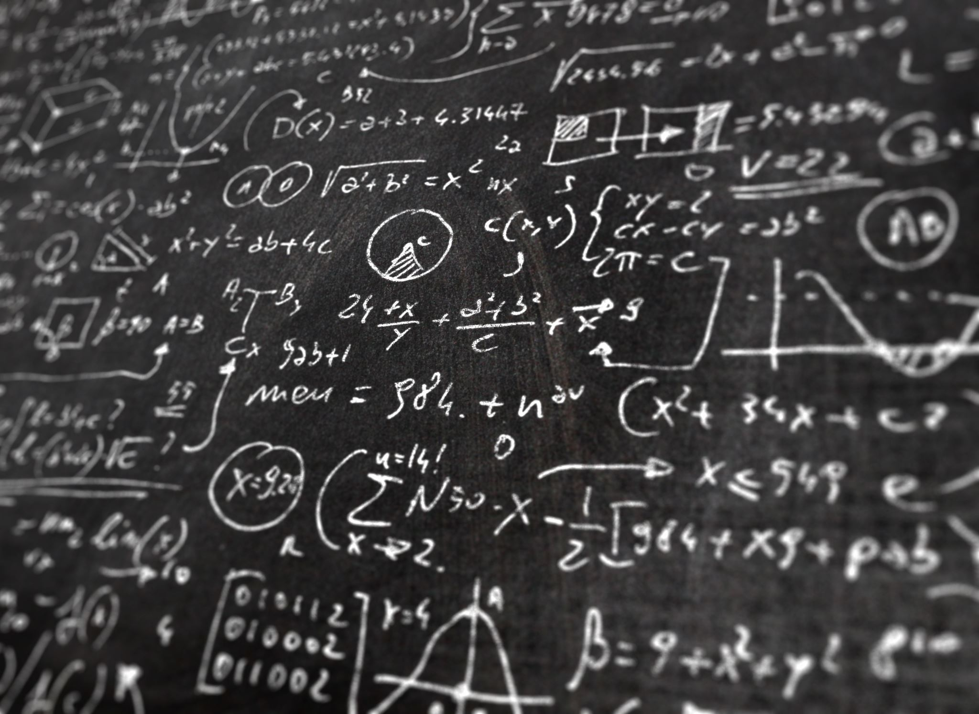
Terminale SPCL - ETLV
The language of charts

Slide 2
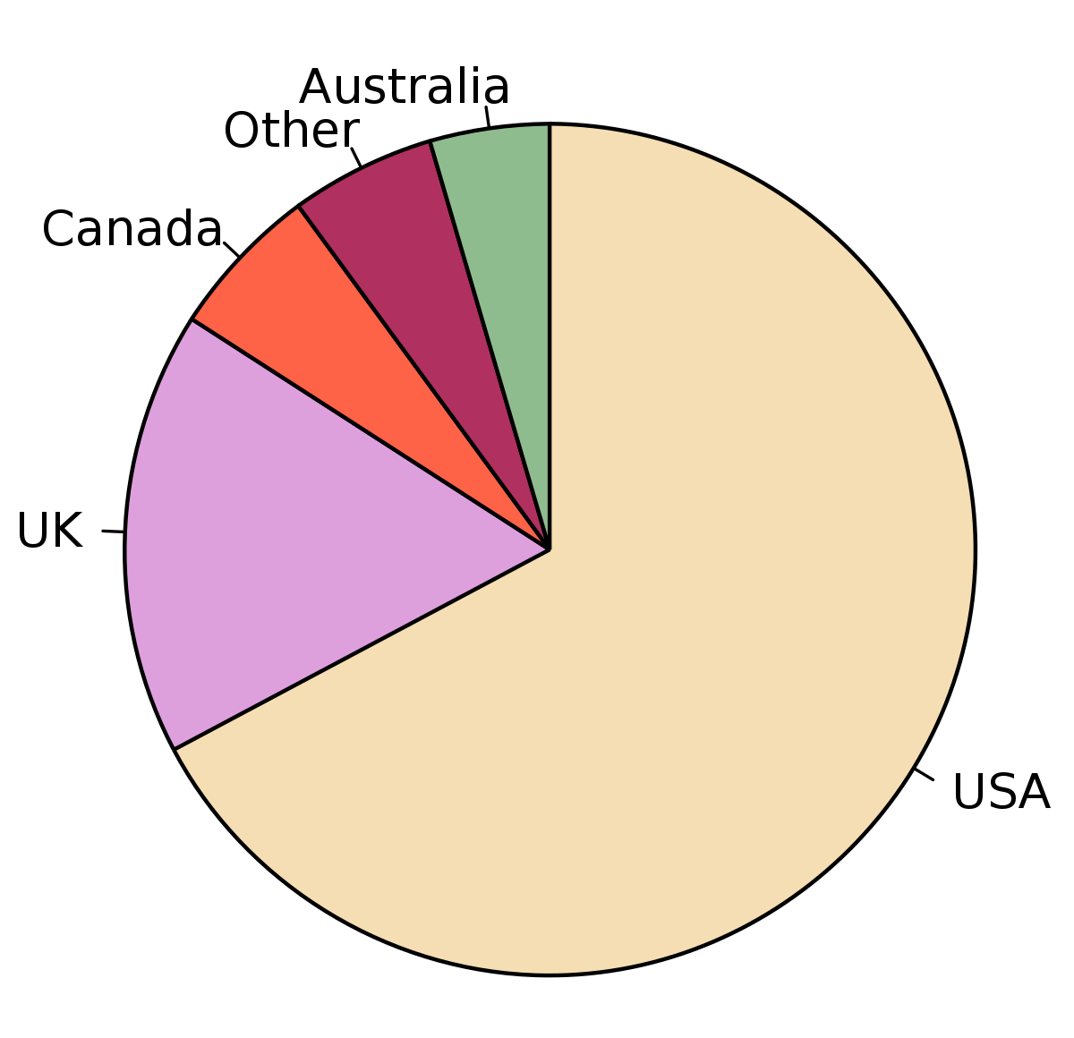
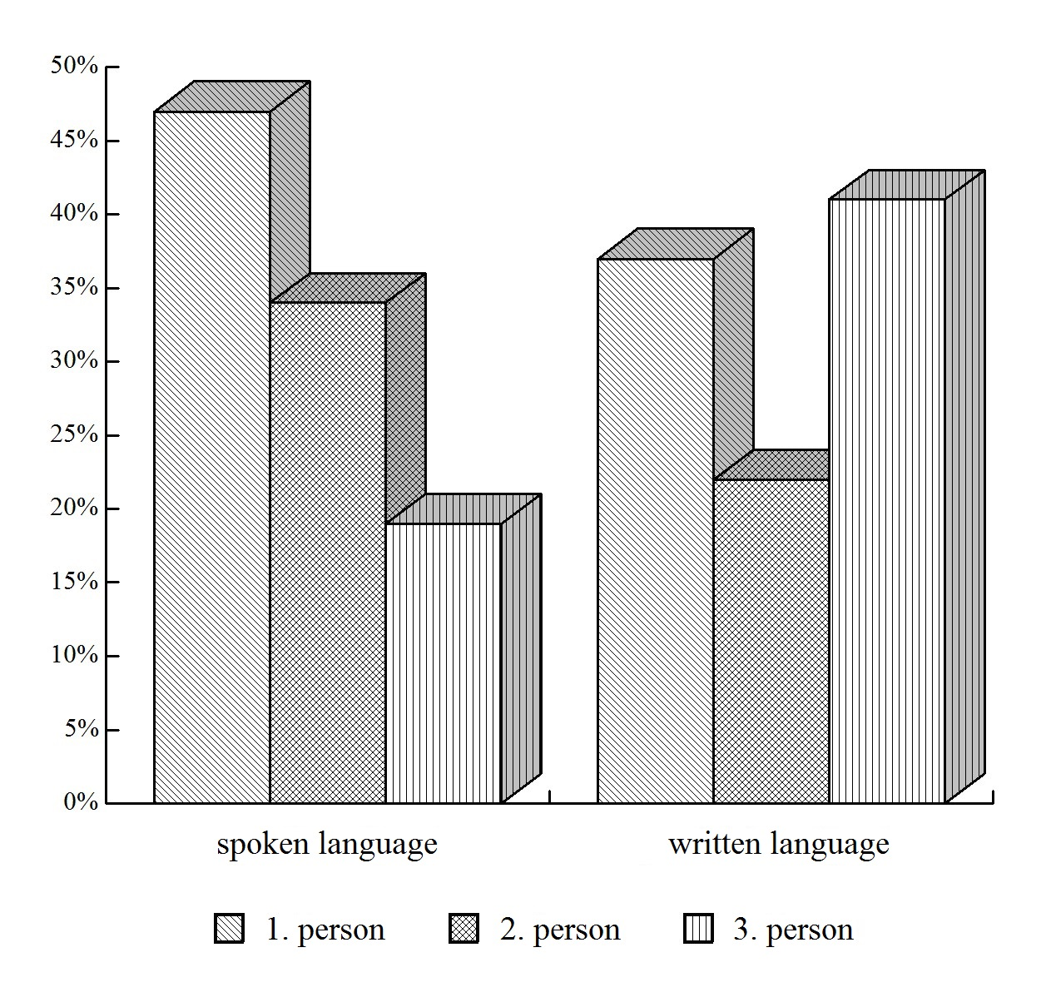
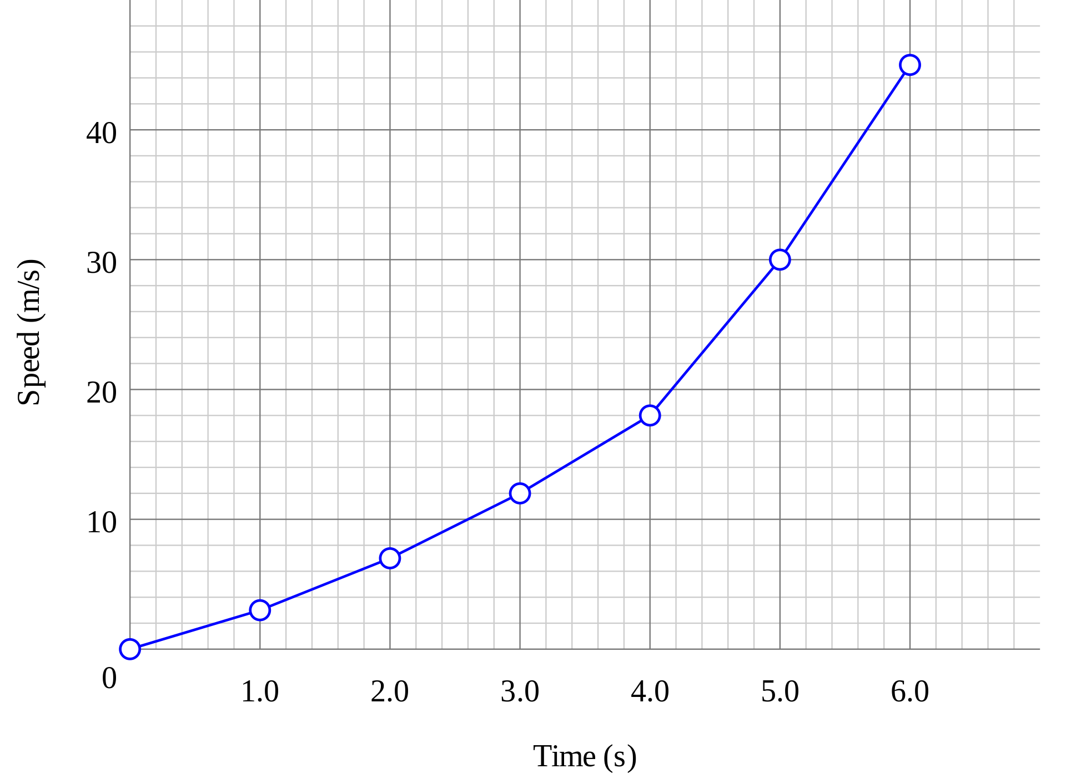
Pie chart bar chart line chart
Types of charts
Source : wikimediacommons

Slide 3
Describing movement
Verbs
to increase to decrease to recover | to go up to go down to jump to slump | to rise to fall To surge to plummet | to improve to decline to reach (+ value) to approach (+ value)
Adjectives
Slight Slightly | Gradual Gradually | Sharp Sharply | Dramatic Dramatically | Major Minor

Slide 4
Use of to decline - There was a gradual decline in the reaction rate - The reaction rate declined gradually
Examples

Slide 5
Use of to increase - There was a 10% increase in paracetamol production in 2021 due to the COVID epidemic. - Paracetamol production increased by 10% in 2021
Examples

Slide 6
Describing stagnation - Average temperatures remained at 16°C in 2015. - Average temperatures remained the same from 2021 to 2022. -Surface sunlight emission continued at 1000W/m² for two years.
Examples

